Slide 1


Predicting house prices for a better future!
Housing Price predictive model – Supervised Learning
Project Contributors – Aayush Gupta, Chris Banh,
Aung Kyaw Zan, Sandeep Sumithran

Slide 2

Introduction
High property prices = stress for first home buyers
Use historical data to predict the current and future
Provide real-time value using machine learning
Goals:
1.Relationship between estate prices and key factors
2.Construction and training of model
3.Predictive power of historical data

Slide 3
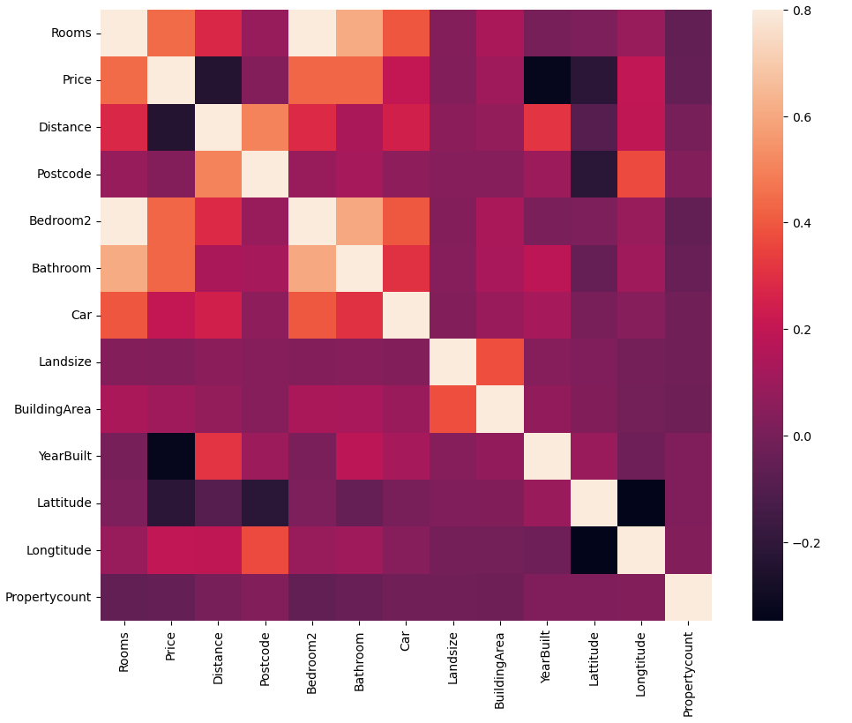
Determine Correlations of Each Columns
Determine the indexes within the data which influences the overall property prices.
Created a heatmap matrix that shows the relationship between each of the columns have with one another.
There can also be inverse relationships denoted by the dark boxes.

Slide 4
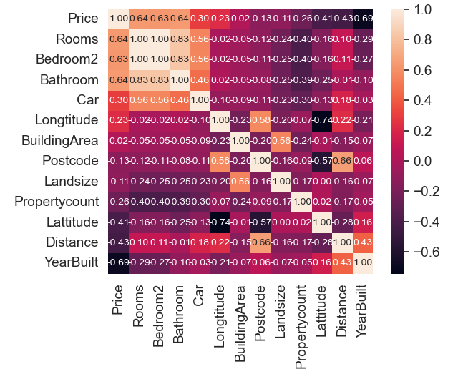
Determine Indexes that Ties to Property Pricing
Created modification to the heatmap so that price is the first index.
Number of rooms within the property is directly proportional to the house price.
Distance and Year Built has an inverse relationship also the magnitude of the effect is also noticeable.

Slide 5
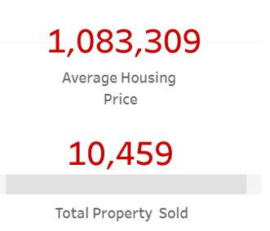
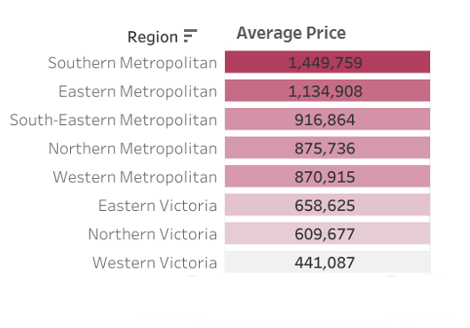
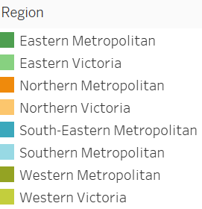
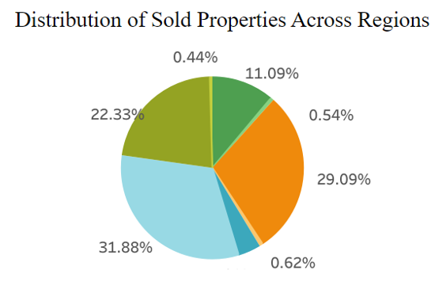
Melbourne's Housing Price Insight (2016-2017)

Slide 6
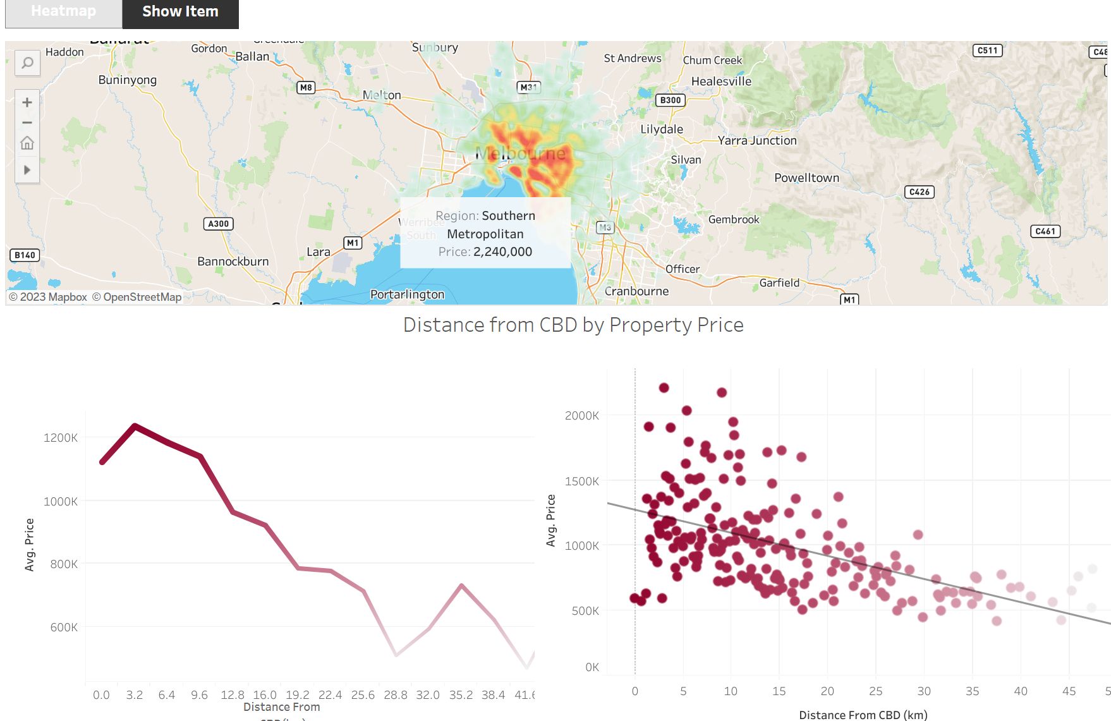
How Distance from the CBD Affects Pricing

Slide 7
Further cleaning the dataset
Decision to further clean the data through removal of indexes that have little to no affect to pricing.
Removed and entries that contains any null values within.
Segregated the region names and concatenated back into the main dataset.
The cleaned dataset was then stored within a PostgreSQL database.

Slide 8
Determining what is the most appropriate machine learning algorithm
What is the best machine learning algorithm that best aids in achieving our goal of a high accuracy rating.
We have experimented with linear regression, gradient boosting, random forest regressor and deep learning (StandardScaler).

Slide 9
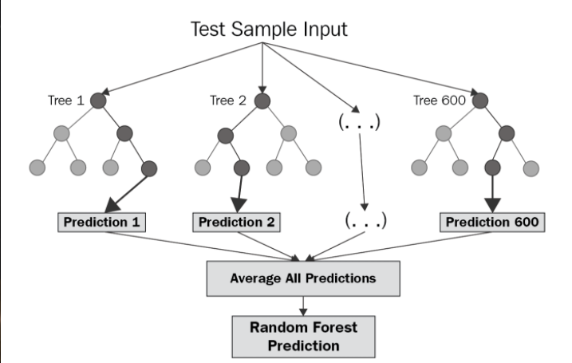
We ultimately chose Random Forest Regressor
Random Forest Regressor allows us to determine a continuous value whilst also been able to handle continuous variables.
It does not require additional setup including normalization of the dataset.
When directly imported from scikit-learn, it yielded the best r^2 value compared to other models without any additional hyperparameter tuning.

Slide 10
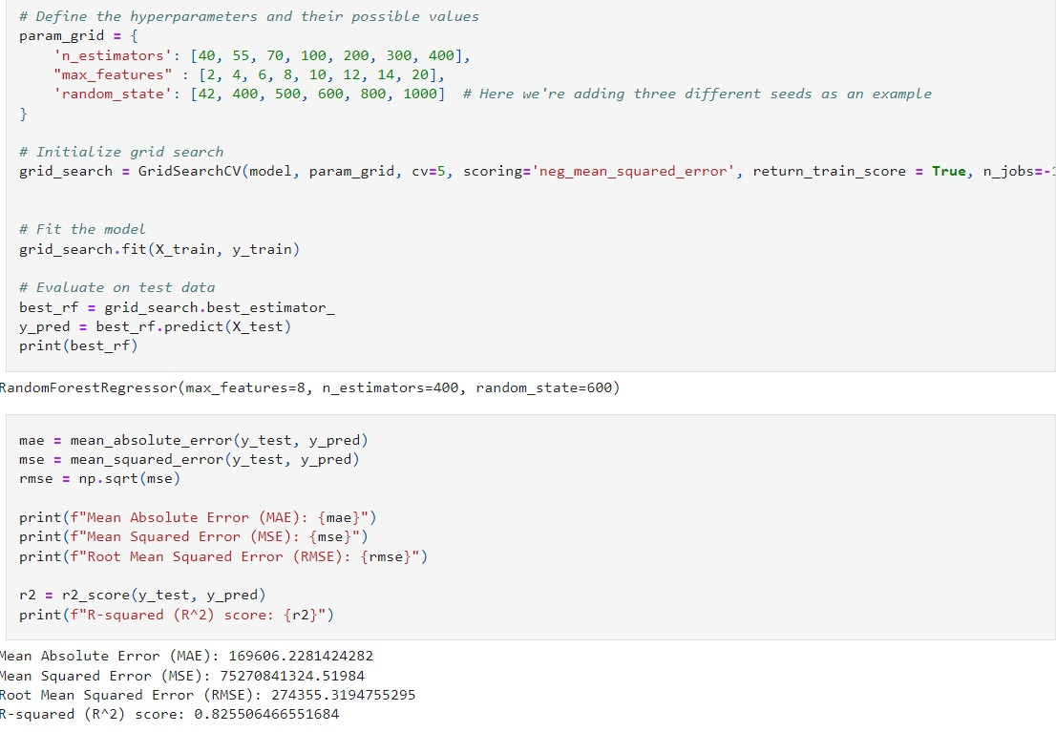
Training the Model
With a target R^2 value of 0.80, we started off my manually tweaking the hyperparameters.
We then decided to let a the scripting to determine the best hyperparameters for us through the use of GridSearchCV for a list of provided values.
Training the model once more using the best hyperparameters provided through the tuner, we we’re able to obtain a Mean Absolute Error of 170k from the average house pricing with an R^2 value of 0.8255.

Slide 11


Mission Success? And reflecting on our project
Originally, our end goal was to develop a web application to allow our target demographic (home buyers) to input various features in which the web application would then return a an estimated price.
A lot of time that we originally had available was mismanaged. Much of it was manually experimenting with various machine learning models and manually tuning the hyperparameters.
Running the script that determines the best hyperparameters is also time consuming through the local server.

Slide 12




Thanks for tuning in! ☺

